Slide 1
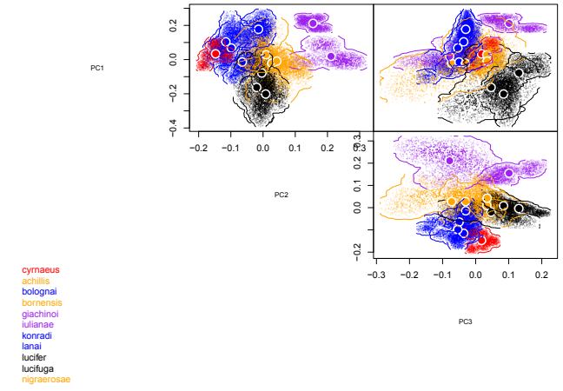
0.2
Fang size
0.0
PCoA 1
-0.2
Leg elongation
Profile reduction
Depigmentation
Leg elongation
Profile reduction
Eye reduction
Depigmentation
Fang size
-0.4
Niche boundary
-0.2
0.0
0.2
Leg elongation
Profile reduction
Random points
PCoA 2
Leg elongation
Profile reduction
Niche centroid
[01] T. cyrnaeus sp. nov
[02] T. bolognai
[03] T. konradi
[04] T. lanai
[05] T. pedemontanus
0.0
PCoA 2
-0.2
Deep cave habitats
Shallow cave habitats
Cave entrance/external
MSS/interstitial
[06] T. achillis
[07] T. bornensis
[08] T. nigraerosae
[09] T. vignai
Depigmentation
Fang size
Depigmentation
Fang size
-0.2
0.0
0.2
[10] T. lucifer
[11] T. lucifuga
[12] T. pluto
PCoA 3
[13] T. giachinoi
[14] T. iulianae

